Slide 1
Deloitte TechnoUtsav 3.0
PLANT DOCTOR
Proposed Solution
IIT Bhilai_404 ERROR

Slide 2
Our Telegram bot is the integration of all the following services in Node-red:
Language Translator:
Used for language identification and language translation of plant names and diseases.
Visual Recognition:
Used for detection of the disease .
Watson Assistant:
Used for retrieving the information about remedies for diseases.
Text to Speech:
Used this service to get the voice message.
Speech to Text:
Used this service to convert the voice message(by user) into text to make it understandable to the watson assistants.

Slide 3
Flow Diagram

Slide 4
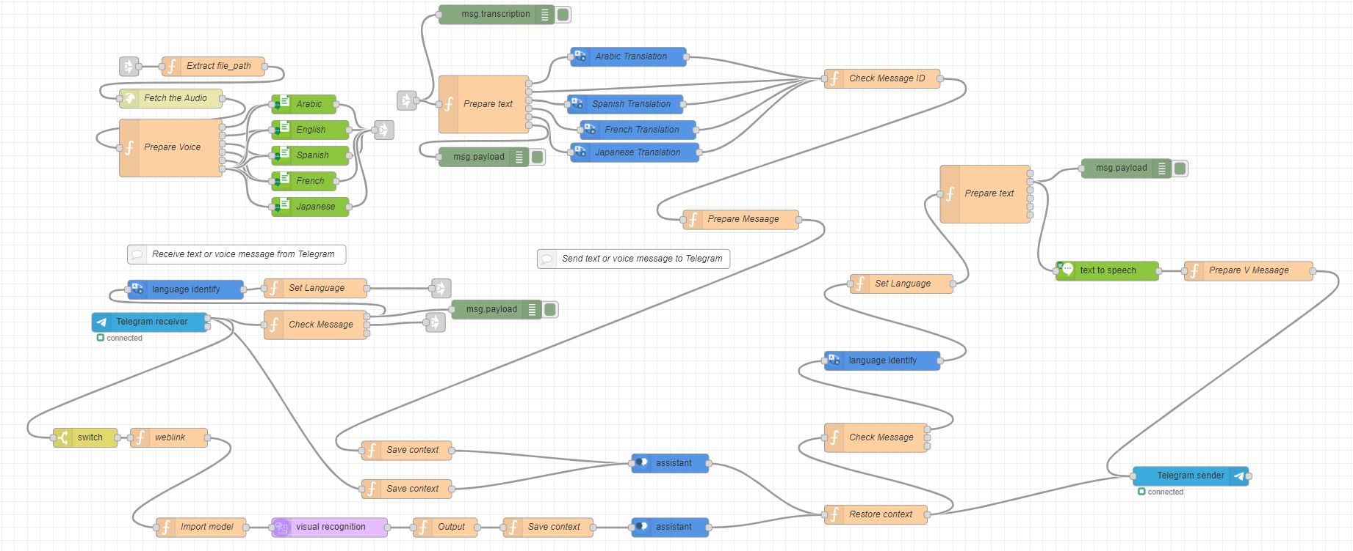

Slide 5

Thank you !

